Slide 1

< 3s
0
innovat3.
Smart NFC Emergency Tags
Alert delivery
Apps needed
Protecting South African families — one tap at a time
3D Printed
IP67 Rated
SA-Built
IP67
SA
hello@innovat3.co.za · innovat3.co.za · WhatsApp
What it does
Any NFC phone taps the tag → emergency profile opens in browser instantly. No app needed. Family gets GPS alert via Telegram and WhatsApp in under 3 seconds.
Waterproof
Made locally
Protecting families · One scan at a time

Slide 2






innovat3.
PROBLEM & SOLUTION
The problem is real. The solution is built.
The Innovat3 solution
No identification in an emergency
When a child is lost or an elderly person wanders, there is no way for a stranger or paramedic to know who they are, who to call, or what medical conditions apply.
Tap to open — no app needed
Any NFC phone (Android or iPhone 7+) opens the emergency profile in the browser instantly. Zero download, zero friction.
GPS captured silently
Delayed response costs lives
GPS captured with up to 5 retries and ≤100m accuracy, then reverse-geocoded to a readable street address.
Paramedics and bystanders spend precious time searching phones and wallets for next-of-kin contacts. Every minute without information increases risk of a poor outcome.
Instant Telegram + WhatsApp alerts
The tag owner receives an immediate alert on both Telegram and WhatsApp with GPS link, subscriber name, and blood type.
Existing solutions require app downloads
Most NFC medical tags ask the finder to install a specific app first. In a real emergency, people do not stop to download software — they give up and move on.
Medical info front and centre
Blood type, conditions, medications, medical aid, and emergency contacts shown immediately — no login needed.
innovat3.co.za
Confidential · 2026

Slide 3




innovat3.
THE PRODUCT
3D printed. NFC powered. Built in South Africa.
NTAG215 chip · PETG housing · Epoxy sealed · IP67 waterproof · Works on any NFC phone since 2018
NTAG215 NFC Chip
3D Printed PETG Housing
Medical ID Ready
504 bytes · ISO 14443A. Works with every NFC phone since 2018 — Android and iPhone — no app required.
Impact-resistant, UV-stable filament. Epoxy-sealed inlay. Fully waterproof to IP67 — survives pools and rough handling.
Blood type, chronic conditions, medications, medical aid, and up to 3 emergency contacts on your live profile.
Glow Edition
10+ Colour Options
Secure Attachment
Glow-in-the-dark PETG charges passively in daylight. Provides 6–8 hours of bright visibility in complete darkness.
Black, Orange, Red, Teal, Blue, Green, Glow Blue, Glitter Green — printed to order, every colour always available.
Embedded magnets click onto watch straps and wristbands. Keyring fob or flat disc form factor — both in stock.
innovat3.co.za
Confidential · 2026

Slide 4

innovat3.
HOW IT WORKS
Scan. Alert. Safe.
From NFC tap to GPS alert in the owner's pocket — under 10 seconds. No app required for the finder.
01
02
03
04
Tap to Scan
GPS Located
Owner Alerted
Logged Forever
›
›
›
Anyone with a modern smartphone holds it near the tag. The emergency profile opens instantly in the browser — no app, no PIN, no friction whatsoever.
The page captures GPS with up to 5 retries and ≤100m accuracy threshold, then converts to a human-readable street address via reverse geocoding.
An instant Telegram message and WhatsApp tap-to-send button reach the tag owner with GPS map link, subscriber name, blood type, and medical alerts.
Every scan is permanently recorded in the subscriber's secure Google Sheet — timestamp, GPS coordinates, reverse-geocoded address, and full medical snapshot.
No app required for the finder · Works on any NFC-enabled Android or iPhone (virtually all phones since 2018)
innovat3.co.za
Confidential · 2026

Slide 5

innovat3.
MARKET OPPORTUNITY
11.5M+
2.4M
1.1M
Children under 12
Elderly living alone
South Africans in our
target addressable market
Wristband · School bag · Shoe tag
Watch strap · Pendant · Walking stick
Gauteng-first launch · National rollout from month 6
INITIAL FOCUS SEGMENTS
Schools and creches — children aged 2–12
4.8M
3.2M
Frail-care facilities and home nurse programmes
Sports clubs, hiking groups and outdoor communities
Active adults
Chronic illness
Sports band · Helmet · Keyring fob
Medical ID · Allergy tag · ICE card
innovat3.co.za
Confidential · 2026

Slide 6

innovat3.
COMPETITIVE LANDSCAPE
The market exists. Our combination does not.
Competitors address parts of the problem. Innovat3 is the only end-to-end solution built for South Africa.
Feature
LifeTags SA
Tap2Tag
TapMedID
innovat3.
SA-based
No app to scan
Live cloud profile
GPS on scan
Telegram owner alerts
WhatsApp owner alerts
3D-printed hardware
Subscription model
innovat3.co.za
Confidential · 2026

Slide 7
innovat3.
BUSINESS MODEL
Subscription + hardware.
Predictable monthly recurring revenue plus a one-time hardware fee per tag. Estimated margins of 65–80% at scale.
SOLO
FAMILY
MOST POPULAR
CARE
R89
R149
R199
/month
/month
once-off
+ R199 one-off · 1 tag
+ R199 per tag
+ R199 per tag · Ages 65+
1 person · 1 custom NFC tag
Up to 4 people · 4 custom tags
Exclusively for people aged 65+
Up to 2 emergency contacts
5 emergency contacts per member
Free monthly subscription for life
WhatsApp + Telegram GPS alerts
Family dashboard · per-member alerts
Unlimited contacts + SMS alerts
Emergency profile + scan history
Full GPS history + priority support
Unlimited history + free replacements
innovat3.co.za
Confidential · 2026
Reseller programme — earn 20% monthly commission on every active subscriber you refer

Slide 8
innovat3.
REVENUE PROJECTIONS
Conservative path to R996K annual run rate in 24 months.
Tag cost ~R45 · Platform hosting ~R200/month · Estimated margin 65–80% at scale
R14,785
R421K
R996K
65–80%
Month 6 MRR
Month 12 Annual
Month 24 Annual
Est. Margin
Month | Solo | Family | Care | Monthly Rev (MRR) | Annual Run Rate
3 | 20 | 15 | 5 | R5,570 | R66,840
6 | 50 | 40 | 15 | R14,785 | R177,420
12 | 120 | 90 | 35 | R35,125 | R421,500
18 | 200 | 150 | 60 | R58,350 | R700,200
24 | 280 | 210 | 90 | R83,000 | R996,000
innovat3.co.za
Confidential · 2026

Slide 9

innovat3.
INTELLECTUAL PROPERTY
Protecting our innovation from day one.
Provisional patent filed with CIPC. Trademark registered. Four unique technical differentiators no competitor has combined.
PATENT PENDING
TRADEMARK FILED
Provisional Application — CIPC (SA)
"Innovat3" Brand Name + Logo
A provisional patent application has been filed with CIPC (SA Patents Office), establishing our priority date. This gives us "Patent Pending" status while we develop the full specification.
The Innovat3 brand name and turtle logo have been filed as a registered trademark with CIPC. This protects our brand identity from imitation and gives us exclusive rights in South Africa.
OUR UNIQUE PROTECTED COMBINATION
3D-printed PETG housing
GPS accuracy validation system
Locally manufactured in SA. No competitor makes their own hardware — we control quality, cost, and design entirely.
5-retry algorithm with ≤100m threshold before sending any alert — families always receive a reliable location.
Dual Telegram + WhatsApp alerts
Live Google Sheets cloud profile
Simultaneous owner notification on both platforms on every scan. No other NFC emergency tag in the world offers this.
Profile updates reflect instantly on the next scan via the gviz API — no admin panel, no app, no delay.
innovat3.co.za
Confidential · 2026

Slide 10
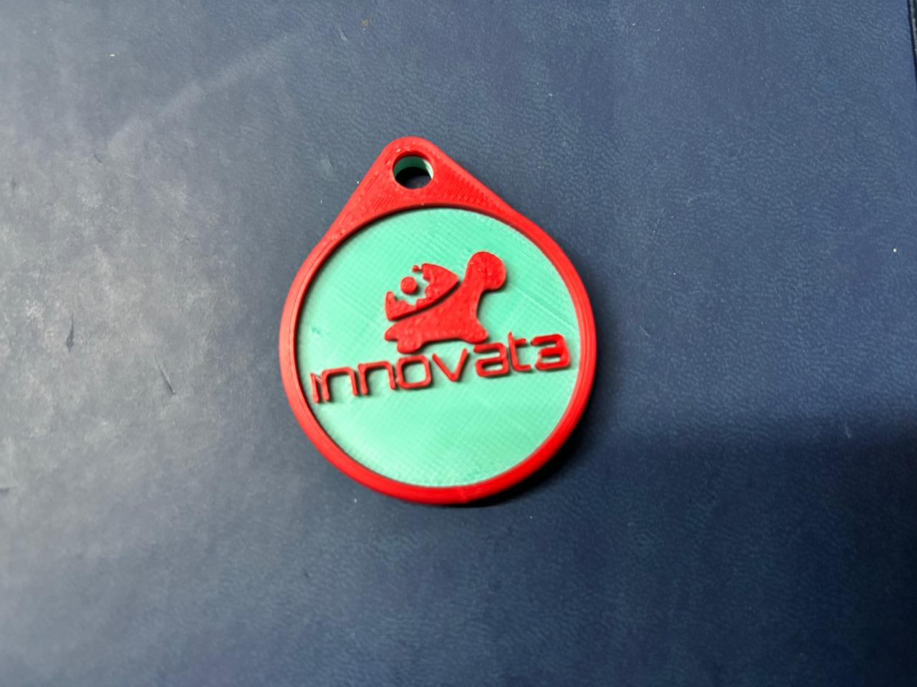

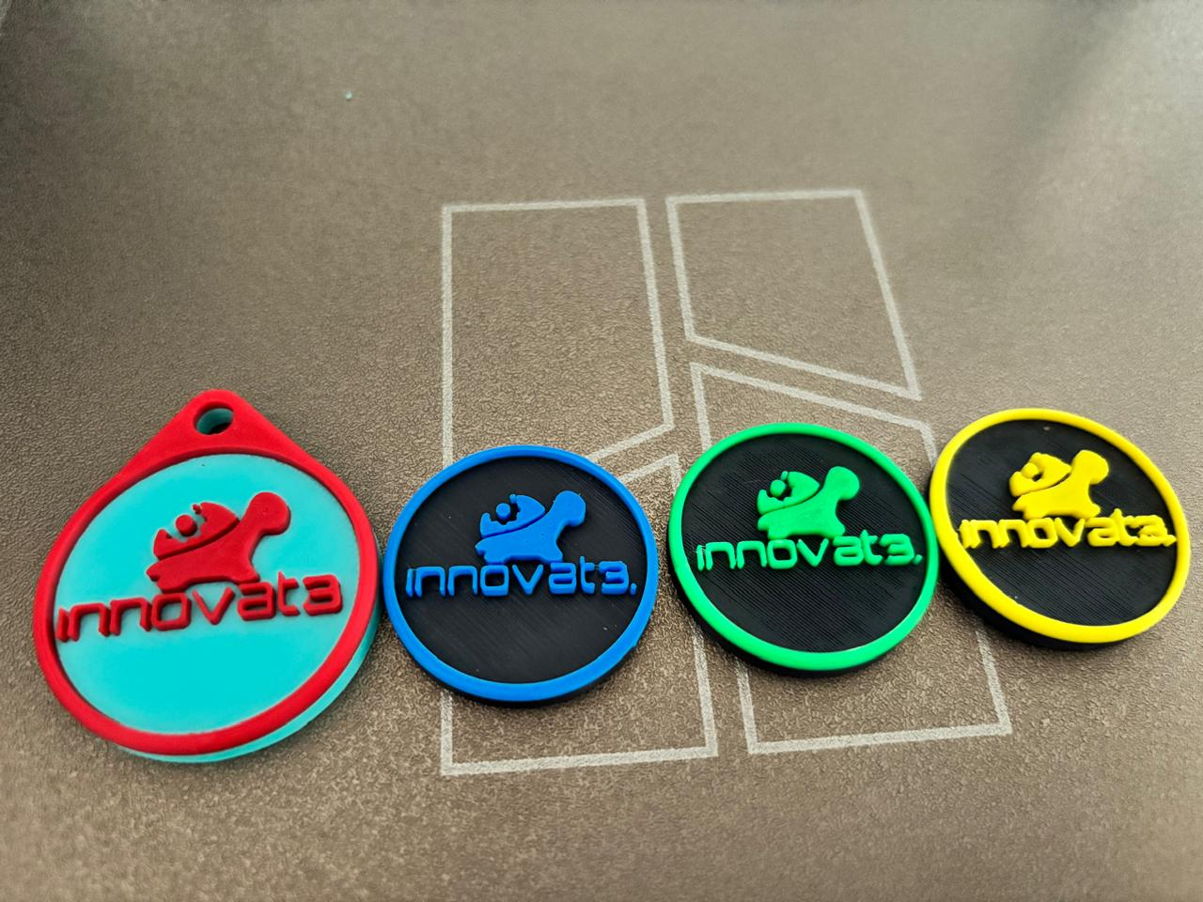
innovat3.
PRODUCT SHOWCASE
Built to survive. Designed to be worn every day.
Tough enough for pools and playgrounds. Discreet enough for offices and hospitals. IP67 rated, epoxy sealed.
Keyring Fob
Full Colour Range
Glow Edition
The most popular form factor. Attaches to keys, school bags, and zip pulls. PETG shell with embedded NTAG215 inlay and IP67 epoxy seal. Survives drops, rain, and full submersion.
Every tag printed to order in your chosen colour. Standard range: Black, Orange, Red, Teal, Blue, and Green. Glitter variants add metallic shimmer. Glow editions charge in daylight.
Glow-in-the-dark PETG filament stores ambient light passively — no batteries, no cable. Provides 6–8 hours of bright blue-green visibility in complete darkness.
innovat3.co.za
Confidential · 2026

Slide 11
innovat3.
LAUNCH ROADMAP
From first tag to 100 subscribers in 60 days.
A focused, low-overhead plan built around community sales, beta feedback, and word-of-mouth. No external funding required.
Weeks 1–2
Weeks 3–4
Weeks 5–6
Month 3+
Foundation
Beta Launch
Public Launch
Scale
Order 50 NTAG215 inlays (~R750)
Deploy to 10 beta families at no cost
Open paid subscriptions publicly
Pharmacy and clinic partnerships
Set up Google Apps Script backend
Collect feedback and fix issues
Run Facebook and WhatsApp ads
Add SMS alert tier
File provisional patent with CIPC
Film product demonstration video
Target: 30 paid subscribers
Target: 200 active subscribers
Register the Innovat3 trademark
Launch all social media pages
Activate reseller programme
National rollout beyond Gauteng
Print 10 prototype beta tags
Confirm all alerts are live
School and frail-care outreach
PayFast auto-activation integration
innovat3.co.za
Confidential · 2026

Slide 12
innovat3.
Smart NFC Emergency Tags · Made in South Africa
EMAIL
hello@innovat3.co.za
WEBSITE
innovat3.co.za
WHATSAPP
Available anytime
Protecting families · One scan at a time

